Slide 1
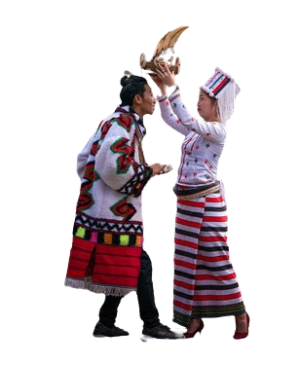
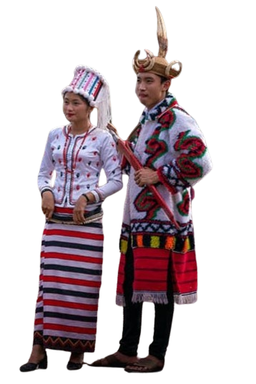
Word Segmentation and
Part-of-Speech Tagging for Rawang Language
Using Conditional Random Fields
Presented by Mabu Phong (6IST-21)
20.2.2024

Slide 2
Outline
Abstract
Objective
Motivation
Introduction
Rawang
Background Theory
System Design
Expected Output
Conclusion and Future work
1

Slide 3
Abstract
There are no available resources for natural language processing (NLP) in the Rawang language.
The proposed system targets Rawang word segmentation and Part-Of-Speech (POS) tagging, representing foundational processes in NLP.
Word segmentation is achieved using the Longest Matching Algorithm using Rawang words corpus.
POS tagging is implemented through Conditional Random Fields model using metrics, refining as needed.
2

Slide 4
Objectives
To preserve Rawang language representing our preserved culture
To develop a diverse Rawang language corpus
To perform word segmentation using longest matching algorithm
To design a tailored CRF model for precise Rawang POS tagging
3

Slide 5
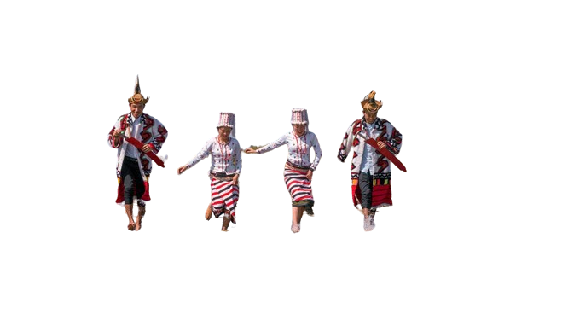
Motivation
Lack of resources for NLP
Lack of developers
Recently-released Grammar version
Dataset availability
Community Encouragement
4

Slide 6
Introduction
NLP is a branch of artificial intelligence (AI) that focuses on the interaction between computers and humans through natural language.
Word segmentation a process of dividing a continuous text into separate words or tokens.
Pos tagging is a process of assigning a grammatical category (such as noun, verb, adjective, etc.) to each word in a given text
5

Slide 7
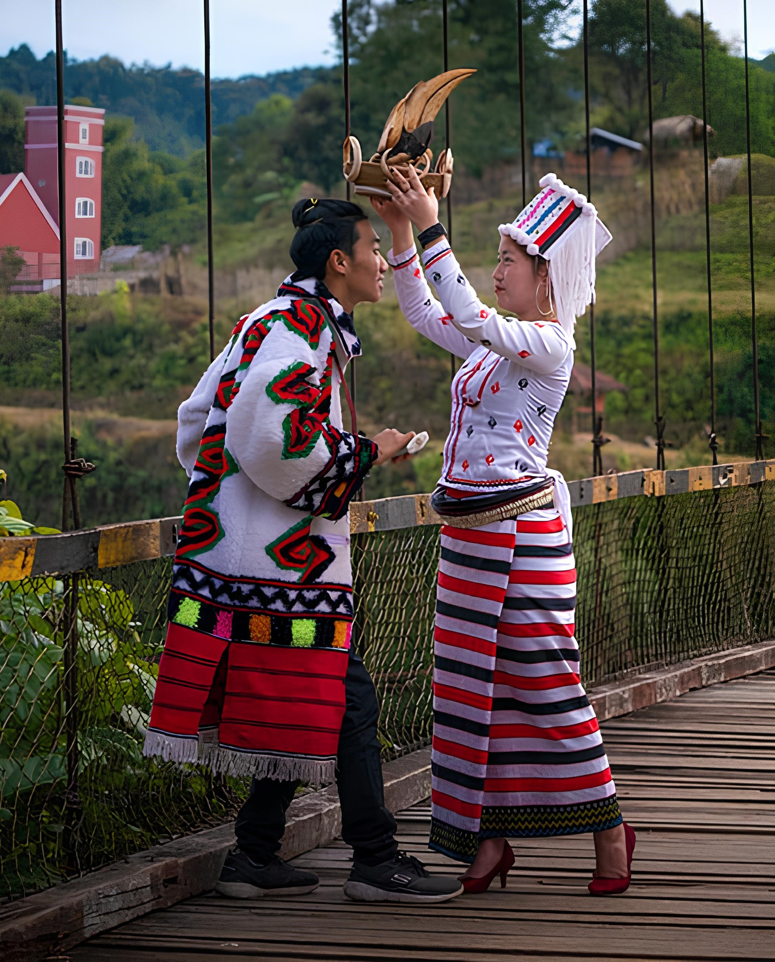
Rawang
Ethnicity code – 109
Spoken by approximately 100,000 Rawang people
Predominantly residing in the Kachin state
Across various regions of Myanmar and have also established communities in foreign countries
The Rawang writing system was initiated in 1940
6

Slide 8

Rawang Writing System (Cont’d)
There are 20 consonants and 6 vowels in Rawang Language
Consonants
Vowels
g k q h ng
j ch sh y r
d t s z n
b p l w m
I E A
V U ø
O
Diacritics : á ā à aq
7

Slide 9
Background Theory
Word segmentation complexity depends on the nature of each language.
In the Rawang language, there is an explicit space between indivitual words or phrases, simplifying the process of word segmentation.
Rawang Text
wervt vsv̀ng dvhø̀taq kagǿ gø laqmàdvshv́ngshì . pàwá wani, adam rvt nø ̀ shvngbe shí vdu dø tiqdvchá , kristu rvt nø̀ shvngbe cúnshì dvzv́rlúngòe . íwe wegǿ nø wegǿò tvyøtaq kristu nø vwat íe.
8

Slide 10
Longest Matching Algorithm
Firstly, split sentence by space obtaining word and phrases before applying this algorithm
Word Corpus
Sentence : “I play tennis youplaybaseball”
I
you
play
tennis
base
ball
baseball
Split with space :
[ I, play, tennis, youplaybaseball ]
Result :
[ I, play, tennis ]
9

Slide 11


Longest Matching Algorithm (Cont’d)
Firstly, split sentence by space obtaining word and phrases before applying this algorithm
Then, phrases are splitted by Longest Matching Algorithm
Word Corpus
Longest Matching
I
you
play
tennis
base
ball
baseball
Phrase : [ youplaybaseball ]
[ you, play, base, ball ]
[ you, play, baseball ]
Result :
[ I, play, tennis, you, play, baseball ]
10

Slide 12
Rawang POS Tag Sets
Case
Chronological Verb
Noun
Conjection
Verb
Adjective
Aux
Preposition
Interjection
Pronoun
Particle
Number
11

Slide 13
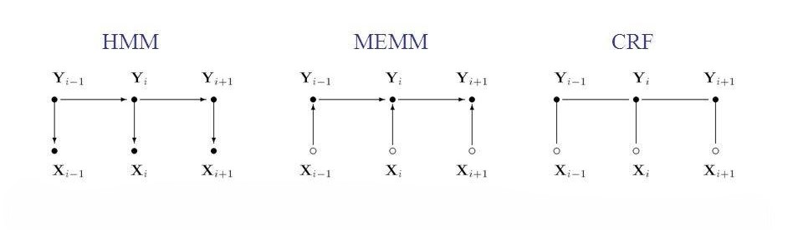
Conditional Random Fields
It is a powerful probabilistic graphical model used primarily for sequential data labeling tasks.
Unlike traditional models, CRFs consider the entire sequence of labels collectively rather than treating each label independently.
It can handle long-range dependencies than traditional model such as HMM, MEMM.
He
likes
mango
Pron
Verb
Noun
12

Slide 14
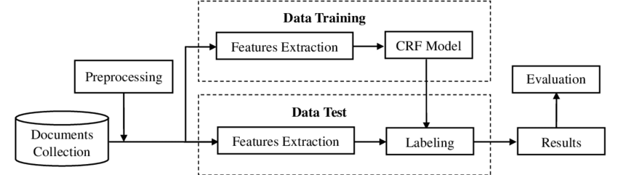
Feature Extraction (Cont’d)
The word itself.
POS tag of the word.
Previous word.
POS tag of previous word.
Second previous word to the given word.
POS tag of second previous word.
Next word.
POS tag of next word.
13

Slide 15
System Design
start
Input Rawang Text
Sentence segmentation
Word Segmentation
Longest Matching Algorithm
Word Corpus
POS Tagging
CRF
Labeled Corpus
Display Words with Tags
End
14

Slide 16
Expected Result
OUTPUT
Input sentence : Yesukristu shøqyanga dang nø íe.
Segmented Words : Yesu kristu shøq yanga dang nø í e .
Pos Tags : noun noun verb adj noun adp verb chro .
15

Slide 17
Conclusion
Thank You
Word segmentation and part-of-speech tagging are initial steps in natural language processing NLP tasks.
This proposed system aims to transcend these initial steps and tackle more complex NLP challenges.
The system adapts and improves over time, ensuring increased accuracy in processing natural language data.
This proposed system incorporates interaction with native speakers and grammar experts, facilitating continual refinement and enhancement of language understanding.
Any Question?
16

Slide 18
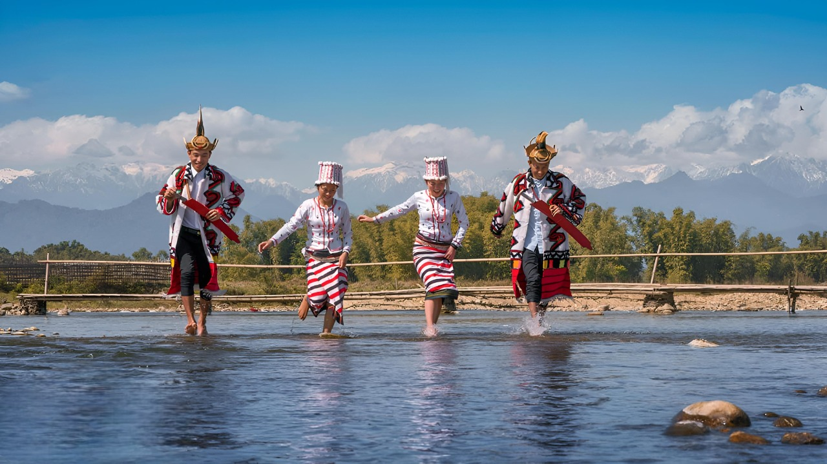
Thank You

